Slide 1


Build Your First AI App with LangChain - Live Project Walkthrough
Live Webinar - Learn with Sarvesh
2nd Nov 2025

Slide 2

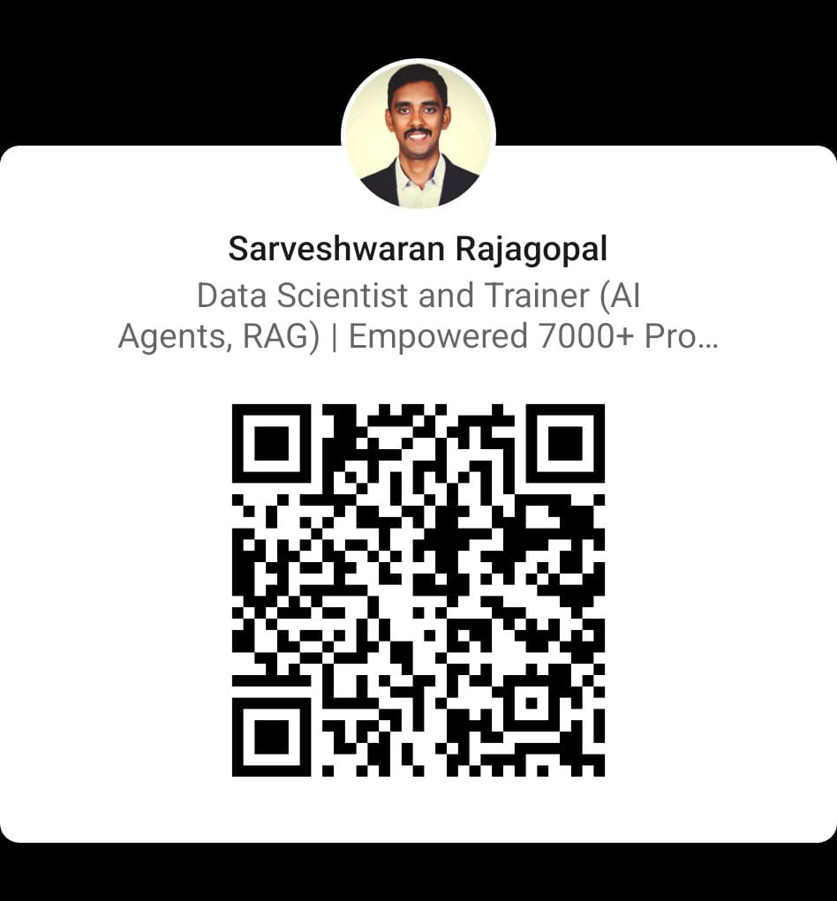

My profile
Sarveshwaran Rajagopal Data Scientist & Trainer (AI Agents, RAG) | Founder – Learn with Sarvesh Empowered 7000+ professionals & students in Data Science & AI

Slide 3
What You’ll Learn Today
Understand how LangChain connects LLMs and your data
1
Learn the workflow: Loader → Embeddings → Vector DB → Chain → Query
2
Build a PDF Q&A assistant step-by-step
3
See how this evolves into a full production app inside the cohort
4

Slide 4
Architecture of the App
📄 PDF → 🧹 Splitter → 🧠 Embeddings → 🗂️ Vector DB → 🤖 LLM → 💬 Answer
LangChain is the bridge between your data and the model.

Slide 5
LangChain Building Blocks
LLM – The brain (GPT-3.5 / GPT-4)
PromptTemplate – How we talk to it
Document Loader – Reads files
Text Splitter – Breaks large docs into chunks
Embeddings + Vector Store – Creates searchable memory
RetrievalQA Chain – Fetches context + answers questions

Slide 6
Project Setup
!pip install langchain openai faiss-cpu pypdf python-dotenv
Checklist:
Python 3.10+
OpenAI API key in .env file
pdf file in project folder

Slide 7
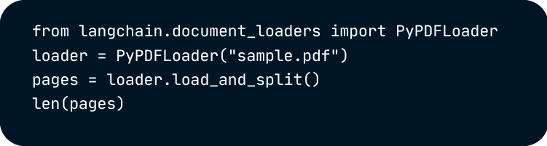

Step 1: Load the Document

Slide 8

Step 2: Create Embeddings

Slide 9
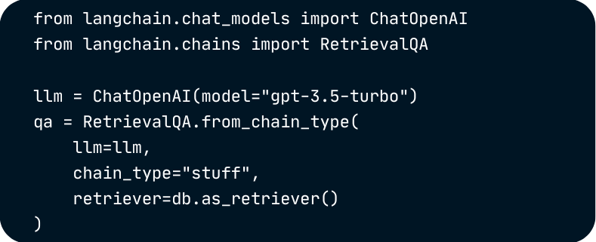
Step 3: Connect the Chain

Slide 10
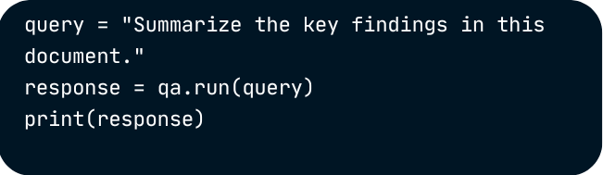
Step 4: Ask Questions

Slide 11
Why Every AI Developer Should Learn LangChain
Framework used by 90% of production LLM apps
Integrates with OpenAI, Anthropic, Ollama, Hugging Face
Powers RAG, Agent, and Automation systems
Essential skill for AI roles in 2025+

Slide 12
What You’ll Build in the LangChain Mastery Cohort
App | What It Does
AI Resume Analyzer | Parse & grade resumes using embeddings
PDF Summarizer | Local RAG-based Q&A over PDFs
AI Email Assistant | Draft emails contextually
YouTube Summarizer | Use yt_dlp + LangChain
Customer Support Bot | FAISS + ChatOpenAI
Travel Itinerary Planner | Multi-tool API Agent
🎯 Every project teaches a real LangChain concept - Chains, Agents, Memory, RAG, Tools, and APIs.

Slide 13
Your 12-Week Journey to AI Builder Mastery
Weeks | Focus
1–2 | LangChain Foundations
3–5 | RAG & Tools
6–8 | Agents + Integrations
9–10 | Deployments & APIs
11–12 | Capstone: End-to-End AI Assistant
By the end, you’ll have 10+ working AI projects & a GitHub portfolio that gets noticed.

Slide 14
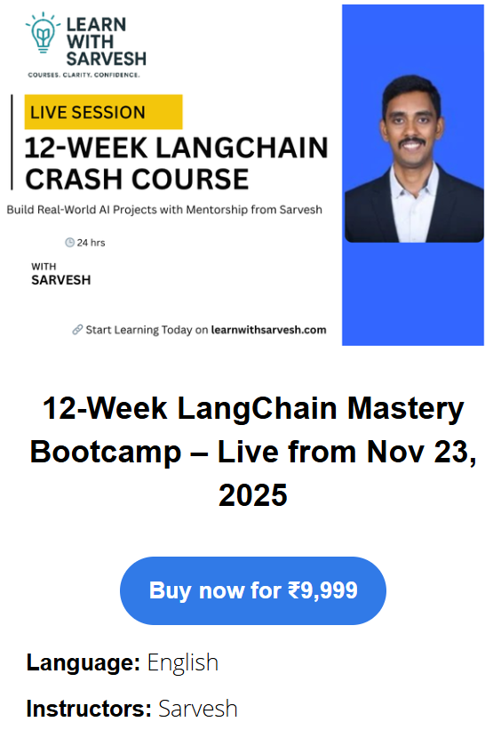
Join the 12-Week LangChain Mastery Cohort — Launching Nov 23! 🚀
💰 Course Fee: ₹9999
🌟 Webinar Offer: 40% OFF - ₹5999 (Use Promo Code: WEB40 – active till 4th Nov )
🚀 Cohort Starts: 23nd November 2025 📍 Duration: 12 Weeks | Weekend Live Sessions 🎥 Mode: Online (Recordings Available)
👉 Enroll Now: 12-week-langchain-mastery-bootcamp (Limited Seats — Offer Valid Only for Webinar Attendees!)

Slide 16

Ask anything - code, projects, tools, or roadmap!

